Slide 1

AI Workshop
By Muhamad Nur Rohman
Day 2
July 6, 2022

Slide 2
Topics
1. Dataset pre-processing | : | Normalization (input and output) | Day 1
 |  | Randomization (shuffle)
 |  | Dataset division (training, validation, and testing)
 |  | Dataset division using cross validation
2. Variable importance analysis | : | Random forest | Day 1
3. AI-based modeling | : | Support vector machine (SVM/SVR) | Day 2
 |  | Random forest for classification/regression
 |  | ANN/DNN
4. Metaheuristic optimization | : | Particle swarm optimization (PSO) | Day 3
5. Hybrid AI-based model – metaheuristic optimization (Hyperparameter tuning) | : | SVR-PSO ANN-PSO DNN-PSO ANN/DNN fine-tuning | Day 4
6. Optimization using machine learning model | : | PSO-SVR | Day 5
7. Object measurement | : | Computer vision / OpenCV | Day 6

Slide 3
SVM/SVR/Random forest Modeling
Dataset collection
Dataset pre-processing
Training and testing
Dataset division
Choose the model
Hyperparameter setting
Training
Evaluation
Satisfy with the performance?
Save the model
Use the model
Hyperparameter tuning

Slide 4
Support Vector Machines (SVM)
Classification: SVM
Regression: Support Vector Regression (SVR)

Slide 5
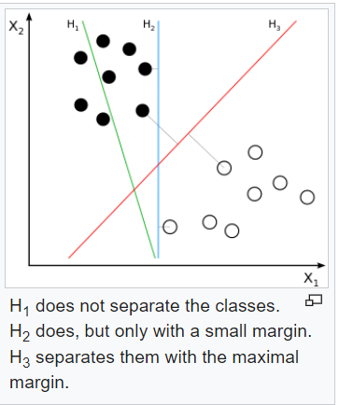
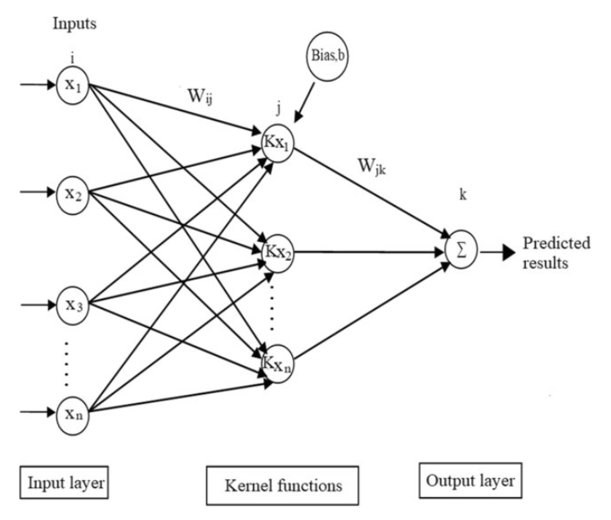
Support Vector Machines (SVM)
Classification
Hyperplane
Kernel: linear, polynomial, rbf, and sigmoid

Slide 6
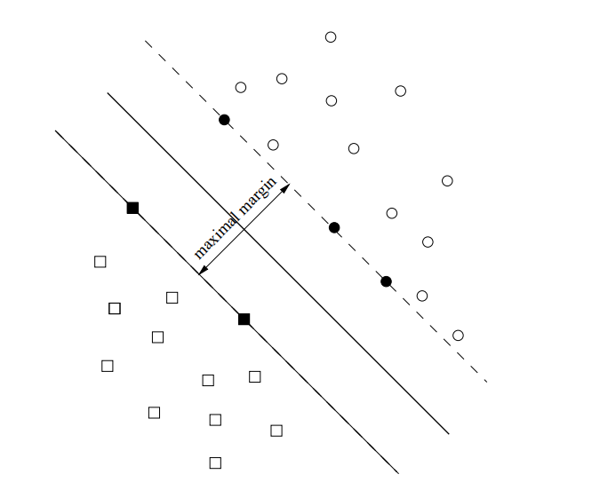
Support Vector Machines (SVM)
Classification

Slide 7
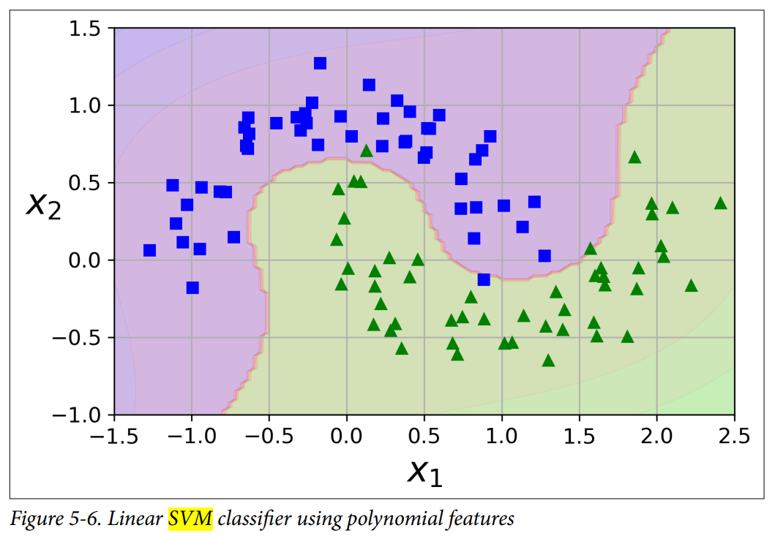
Support Vector Machines (SVM)
Classification

Slide 8
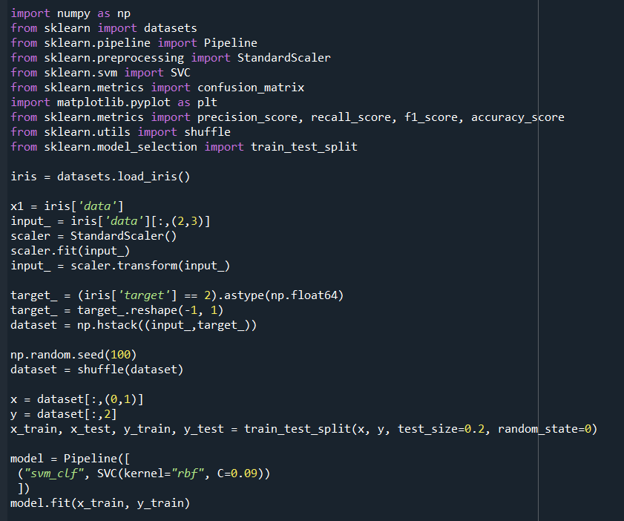
Support Vector Machines (SVM)
Classification
Import libraries
Python implementation
Collect dataset
Exercise 5
Dataset pre-processing
Dataset division
Choose a model
Training

Slide 9
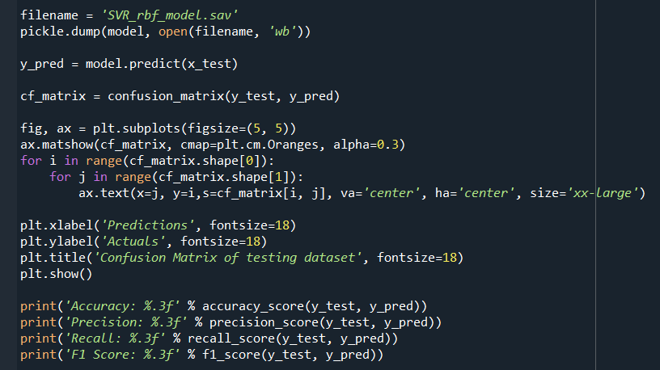
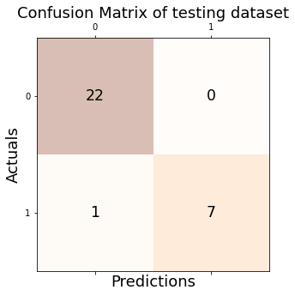

Support Vector Machines (SVM)
Save the model
Classification
Python implementation
Performance calculation

Slide 10
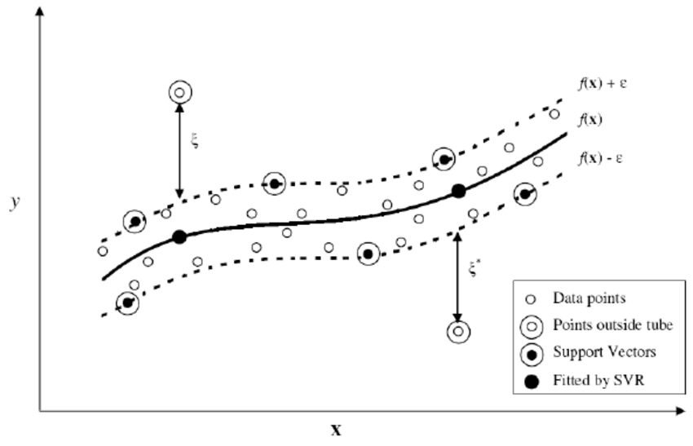
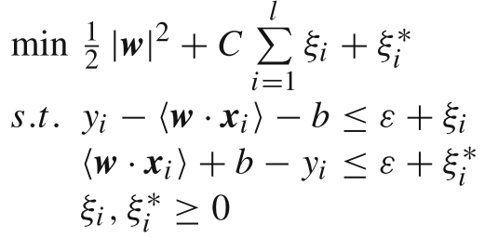
Support Vector Regression (SVR)
Kernel: linear, polynomial, rbf, and sigmoid

Slide 11
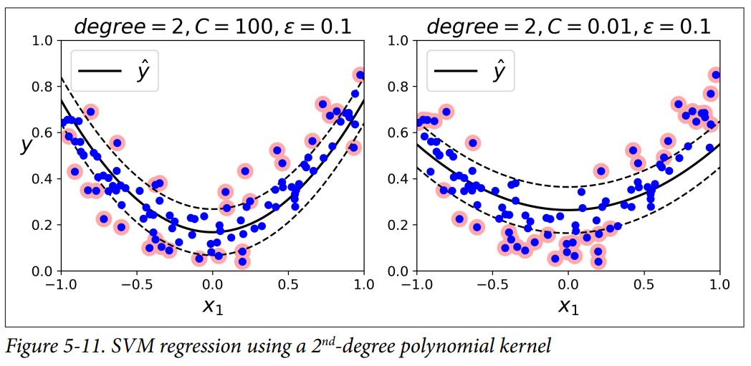
Support Vector Regression (SVR)
Regression

Slide 12
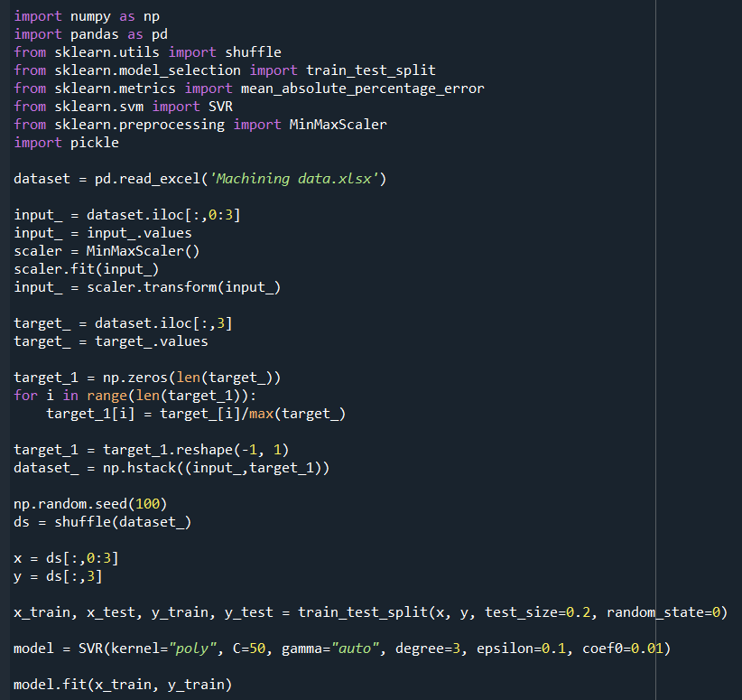
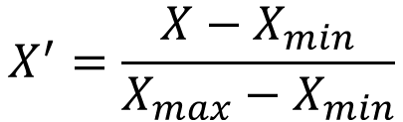
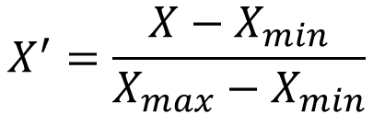
Support Vector Regression (SVR)
Regression
Python implementation
Exercise 6
Input normalization:
$$X^{′}=\frac{X−X_{min}}{X_{max}−X_{min}}$$
Output/target normalization:
= 0
$$X^{′}=\frac{X−X_{min}}{X_{max}−X_{min}}$$
= 0

Slide 13
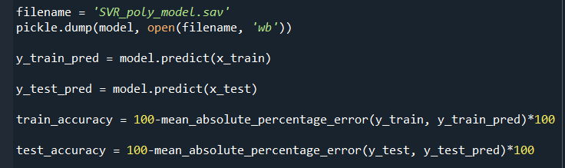
Support Vector Regression (SVR)
Regression
Python implementation
Exercise 6

Slide 14
Random forest
Classification
Python implementation
from sklearn.ensemble import RandomForestClassifier
model = RandomForestClassifier(n_estimators=500, max_leaf_nodes=16, n_jobs=-1)
Exercise 7
Create a model using RandomForestClassifier
Use datasets in Exercise 5

Slide 15
Random forest
Regression
Python implementation
from sklearn.ensemble import RandomForestRegressor
model = RandomForestRegressor(n_estimators = 100, random_state = 0)
Exercise 8
Create a model using RandomForestRegressor
Use datasets in Exercise 6

Slide 16
ANN/DNN Modeling
Dataset collection
Dataset pre-processing
Training, validation, and testing
Dataset division
Choose the model
Hyperparameter setting
Training
Evaluation
Satisfy with the performance?
Save the model
Use the model
Hyperparameter tuning

Slide 17
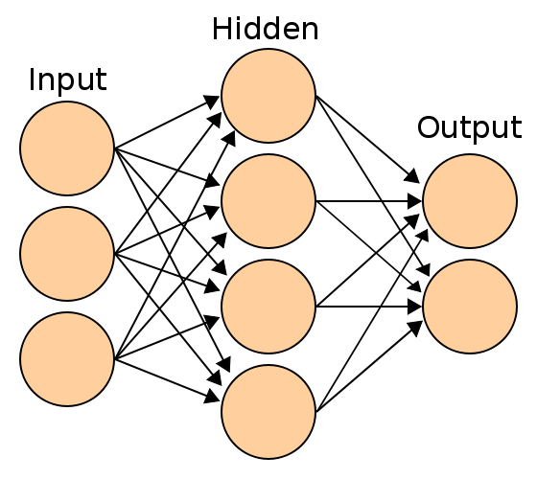
Artificial Neural Network (ANN)
Shallow Neural Network (SNN)

Slide 18
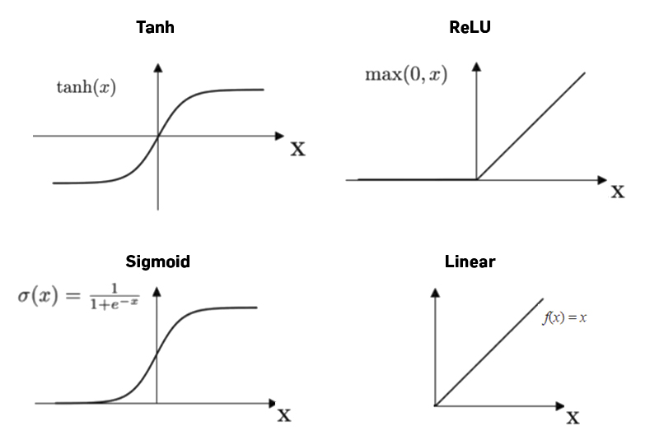
Activation functions
examples

Slide 19
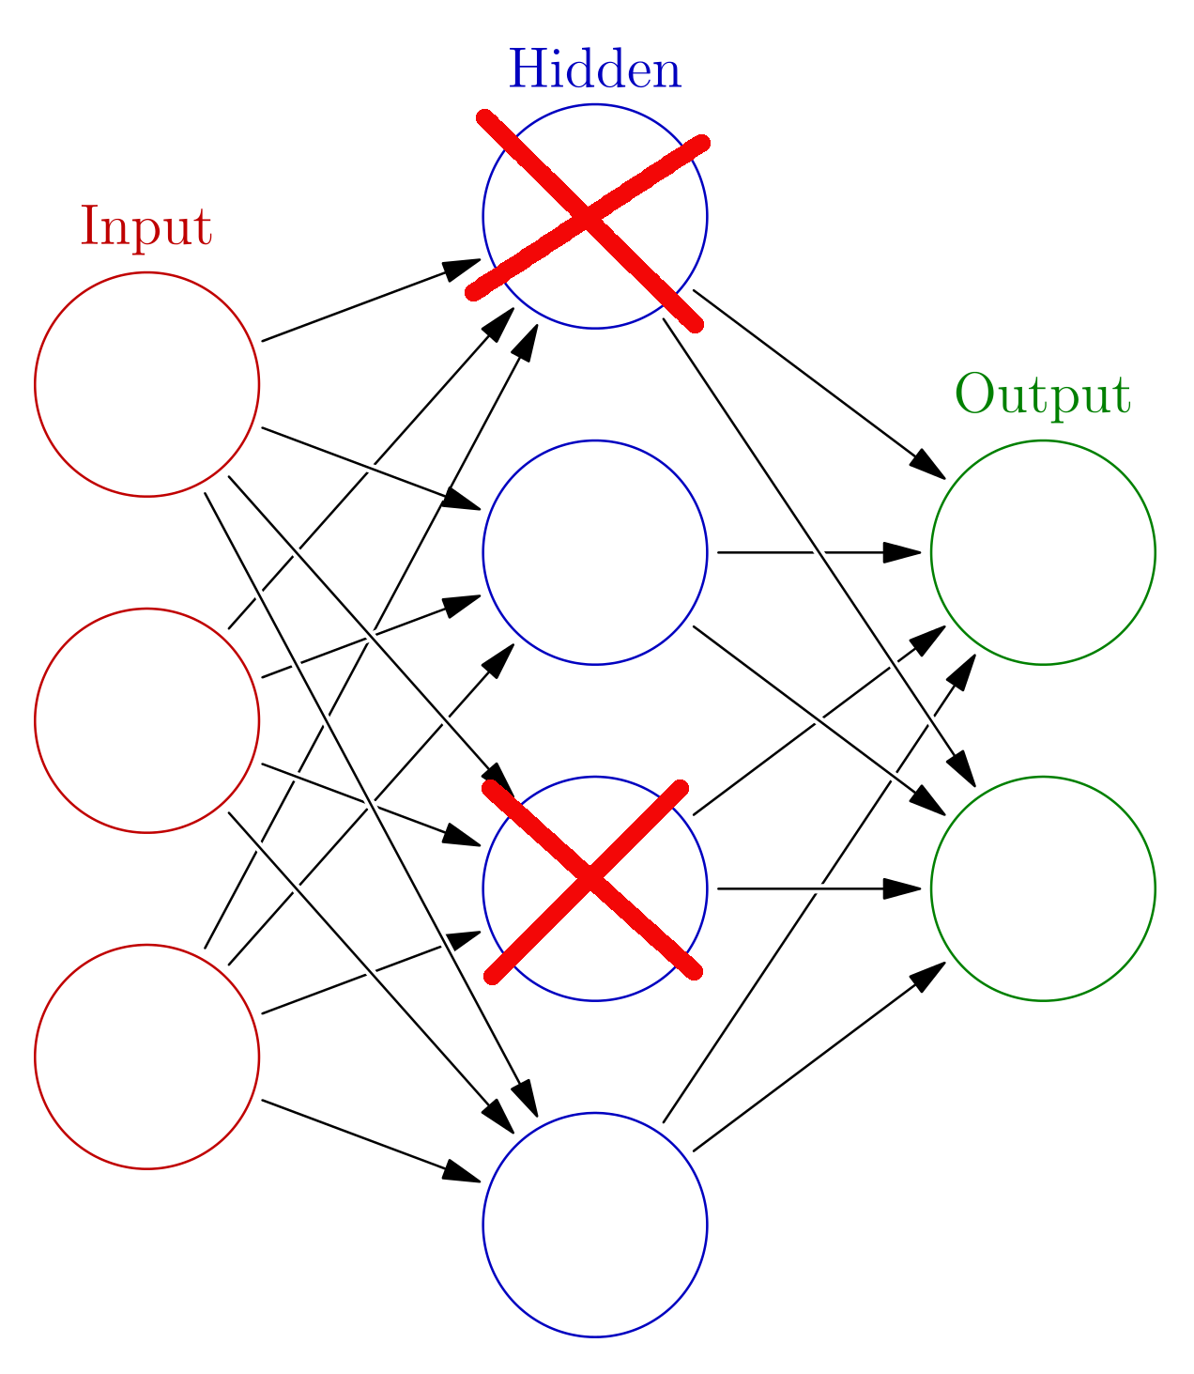
Dropout
During the training phase, a certain proportion (dropout rate) of the nodes are abandoned randomly, whose weights are not updated.
Dropout rate: 0 < DO ≤ 0.5

Slide 20
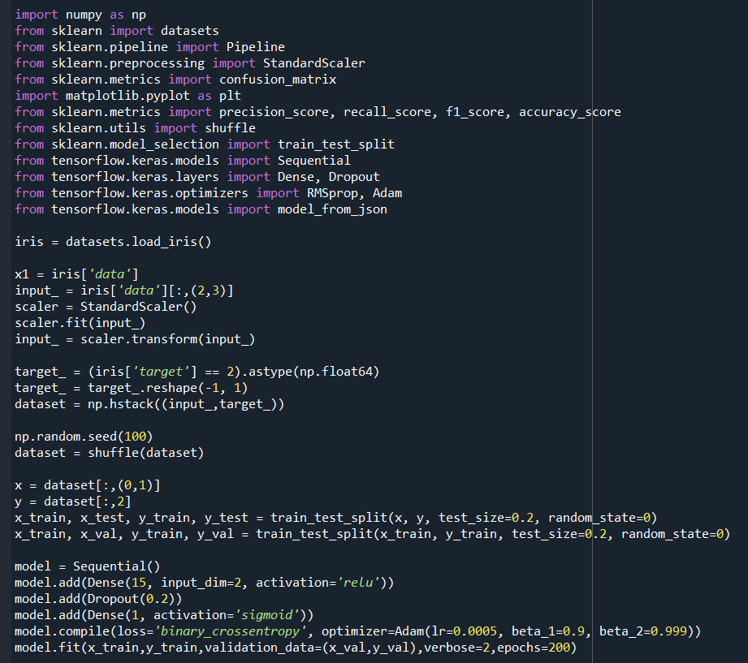
Shallow Neural Network (SNN)
Classification
Python implementation
Exercise 9

Slide 21
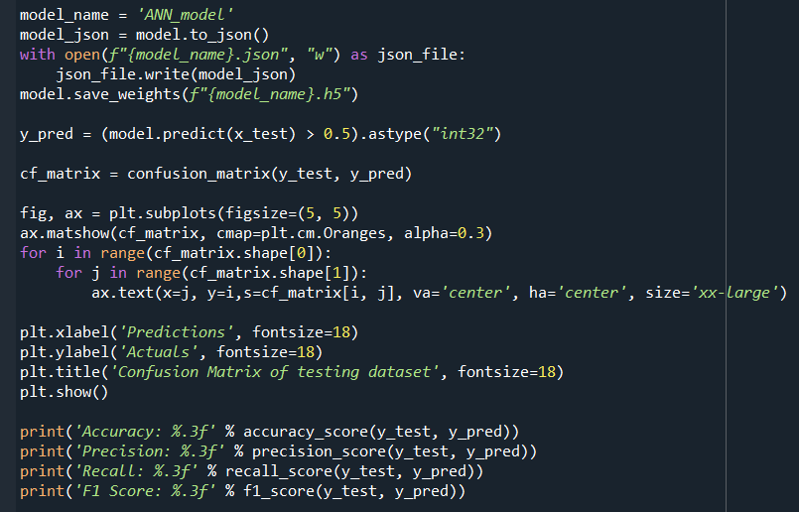
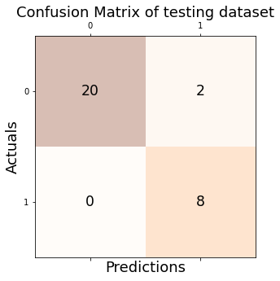

Shallow Neural Network (SNN)
Classification
Python implementation

Slide 22
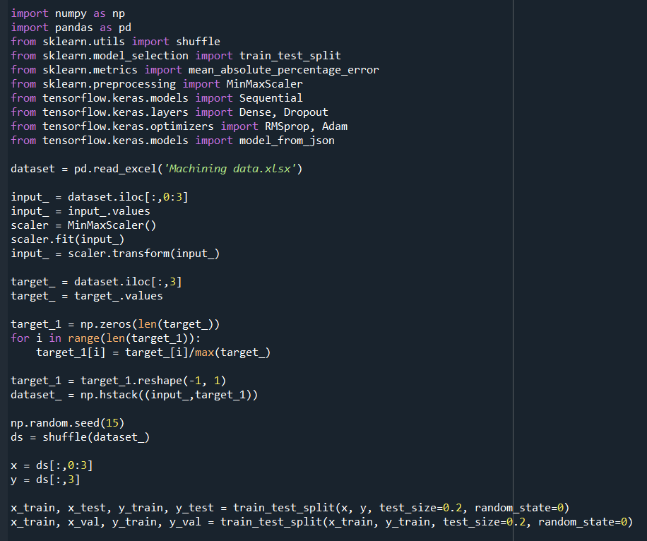
Shallow Neural Network (SNN)
Regression
Python implementation
Exercise 10

Slide 23
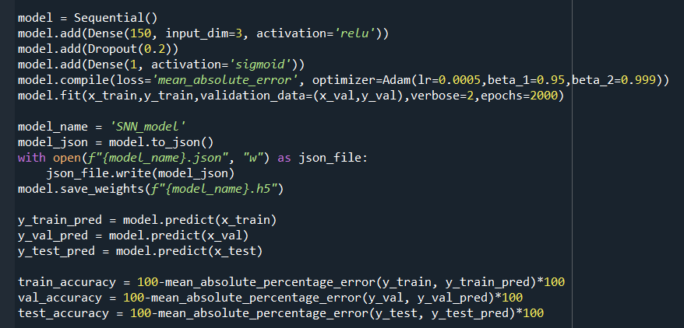
Shallow Neural Network (SNN)
Regression
Python implementation
Exercise 10

Slide 24
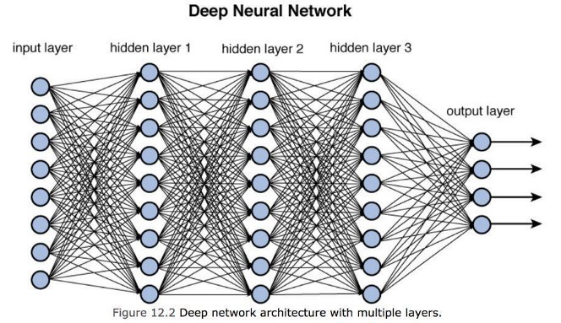
Artificial Neural Network (ANN)
Deep Neural Network (DNN)

Slide 25
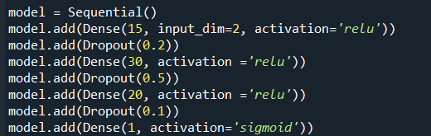
Deep Neural Network (DNN)
Classification
Python implementation
Exercise 11
Create a model using DNN with 3 hidden layers
Use datasets in Exercise 5

Slide 26
Deep Neural Network (SNN)
Regression
Python implementation
Exercise 12
Create a model using DNN with 4 hidden layers
Use datasets in Exercise 6

Slide 27
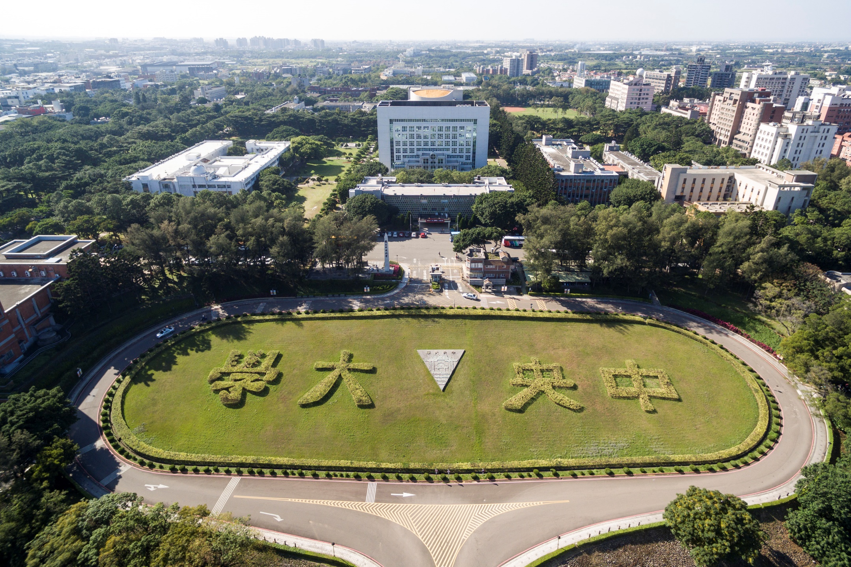
Thank you for your attention

